Slide 1
人去樓空
Empty Pew
啟示錄 Revelation 2:12-17

Slide 2
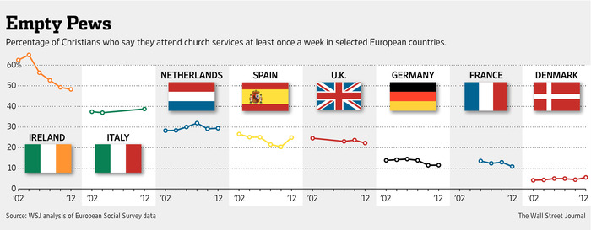
Notes:
The Church of England closes about 20 churches a year. Roughly 200 Danish churches have been deemed nonviable or underused. The Roman Catholic Church in Germany has shut about 515 churches in the past decade.
But it is in the Netherlands where the trend appears to be most advanced. The country’s Roman Catholic leaders estimate that two-thirds of their 1,600 churches will be out of commission in a decade, and 700 of Holland’s Protestant churches are expected to close within four years.

Slide 3
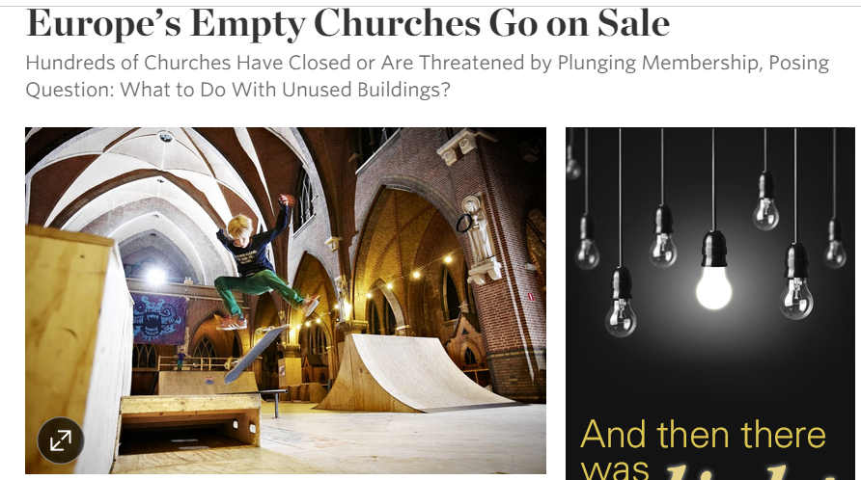
Notes:
http://www.wsj.com/articles/europes-empty-churches-go-on-sale-1420245359

Slide 4
1. 並非逼迫打敗教會 (2:13)
Persecution Doesn’t Destroy the Church
¹³ 我知道你的居所，就是有撒但座位之處；當我忠心的見證人安提帕在你們中間、撒但所住的地方被殺之時，你還堅守我的名，沒有棄絕我的道。
¹³ I know where you live—where Satan has his throne. Yet you remain true to my name. You did not renounce your faith in me, not even in the days of Antipas, my faithful witness, who was put to death in your city—where Satan lives.

Slide 5
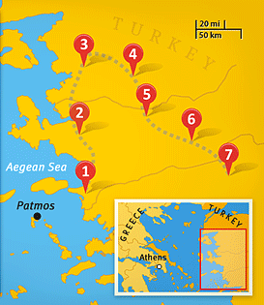
3. 別迦摩
Pergamum

Slide 6
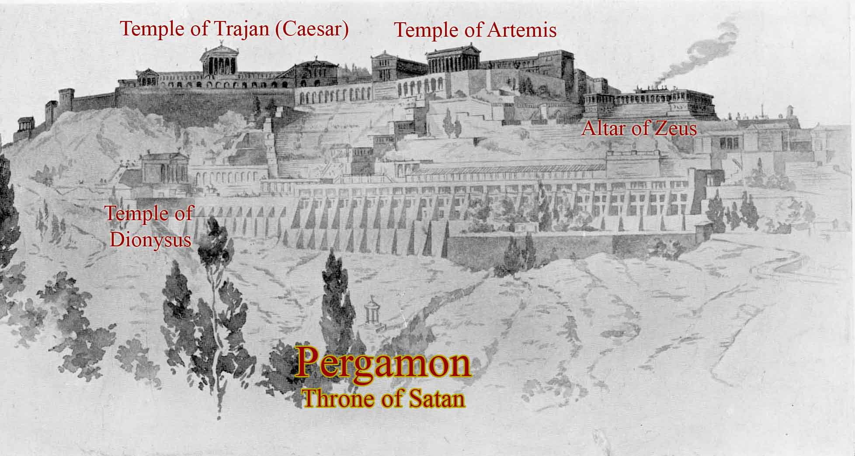
Notes:
https://stevehyde.wordpress.com/2011/04/03/the-temple-of-satan/

Slide 7
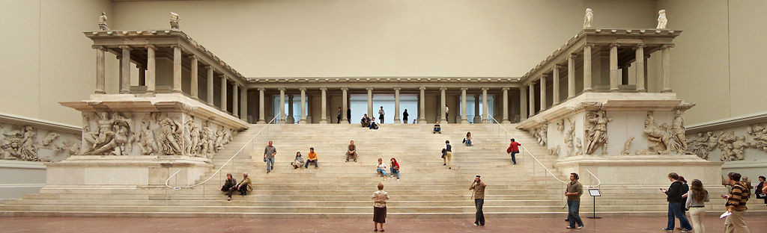
The Great Altar of Zeus from Pergamum
Notes:
Reconstruction of the Great Altar of Zeus from Pergamum, now in the Pergamon Museum in Berlin.
Mare, W. H. (2004). New Testament Background Commentary: A New Dictionary of Words, Phrases and Situations in Bible Order (p. 430). Ross-shire, UK: Mentor.
https://en.wikipedia.org/wiki/Pergamon_Altar

Slide 8
1. 並非逼迫打敗教會 (2:13)
Persecution Doesn’t Destroy the Church
¹³ 我知道你的居所，就是有撒但座位之處；當我忠心的見證人安提帕在你們中間、撒但所住的地方被殺之時，你還堅守我的名，沒有棄絕我的道。
¹³ I know where you live—where Satan has his throne. Yet you remain true to my name. You did not renounce your faith in me, not even in the days of Antipas, my faithful witness, who was put to death in your city—where Satan lives.

Slide 9
2. 妥協腐蝕教會 (2:14-15)
Compromise Erodes the Church
¹⁴ 然而，有幾件事我要責備你：因為在你那裏有人服從了巴蘭的教訓；這巴蘭曾教導巴勒將絆腳石放在以色列人面前，叫他們吃祭偶像之物，行姦淫的事。
¹⁴ But I have a few things against you: you have some there who hold the teaching of Balaam, who taught Balak to put a stumbling block before the sons of Israel, so that they might eat food sacrificed to idols and practice sexual immorality. (ESV)

Slide 10
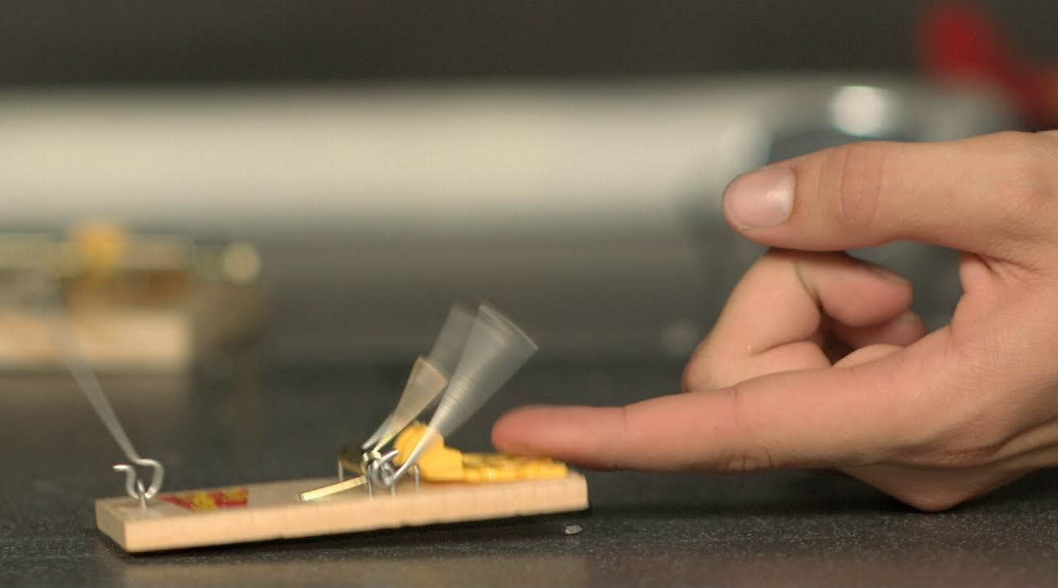
絆腳石 stumbling block
σκάνδαλον - the trigger peg in an animal trap

Slide 11
Numbers 25:1–2
¹ 以色列人住在什亭，百姓與摩押女子行起淫亂。² 因為這女子叫百姓來，一同給她們的神獻祭，百姓就吃她們的祭物，跪拜她們的神。
¹ While Israel was staying in Shittim, the men began to indulge in sexual immorality with Moabite women, ² who invited them to the sacrifices to their gods. The people ate the sacrificial meal and bowed down before these gods.

Slide 12
Notes:
https://stevehyde.wordpress.com/2011/04/03/the-temple-of-satan/

Slide 13
1 Corinthians 6:12
¹² … 凡事我都可行，但無論哪一件，我總不受它的轄制。
¹² … “I have the right to do anything”—but I will not be mastered by anything.

Slide 14
3. 勝過妥協之法 (16-17)
Ways to Conquer Compromise
Revelation 2:16
¹⁶ 所以，你當悔改；
¹⁶ Repent therefore!

Slide 15
1 Corinthians 5:6
⁶ … 豈不知一點麵酵能使全團發起來嗎？
⁶ … Don’t you know that a little yeast leavens the whole batch of dough?

Slide 16
3. 勝過妥協之法 (16-17)
Ways to Conquer Compromise
Revelation 2:16
¹⁶ … 若不悔改，我就快臨到你那裏，用我口中的劍攻擊他們。
¹⁶ … Otherwise, I will soon come to you and will fight against them with the sword of my mouth.

Slide 17
Revelation 2:17
¹⁷ 聖靈向眾教會所說的話，凡有耳的，就應當聽！得勝的，我必將那隱藏的嗎哪賜給他，並賜他一塊白石，石上寫著新名；除了那領受的以外，沒有人能認識。』」
¹⁷ Whoever has ears, let them hear what the Spirit says to the churches. To the one who is victorious, I will give some of the hidden manna. I will also give that person a white stone with a new name written on it, known only to the one who receives it.

